Slide 1
CREDIT EDA CASE STUDY
BY:- ZISHAN AHMED

Slide 2
Analysis Done:
Checked shape of Data frame
Checked column wise data types
Checked missing values and handled missing values
Checked and Dropped columns which have null values more than or equal to 50%
Dopped unnecessary columns from data frame for further analysis

Slide 3
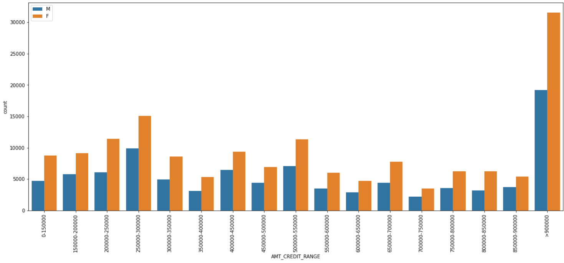
DISTRIBUTION OF AMT_CREDIT_RANGE
Points to be concluded from the Graph on right side.
Count of Female is more than male
Female Credit range is max at AMT_CREDIT_RANGE>900000

Slide 4
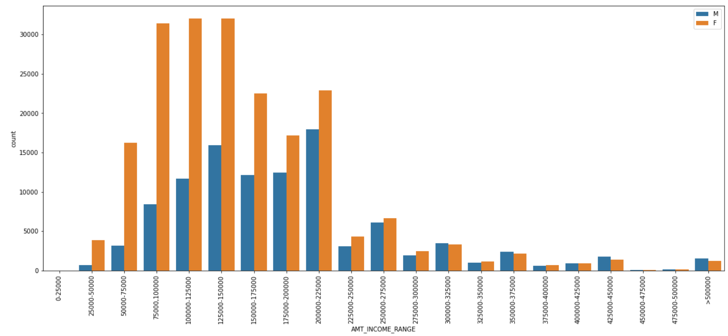
DISTRIBUTION OF AMT_INCOME_RANGE
Points to be concluded from the Graph on right side.
Income of the Female workers are higher in 75000 to 225000
Most of the employees lies in the salary range of 75000 to 225000

Slide 5
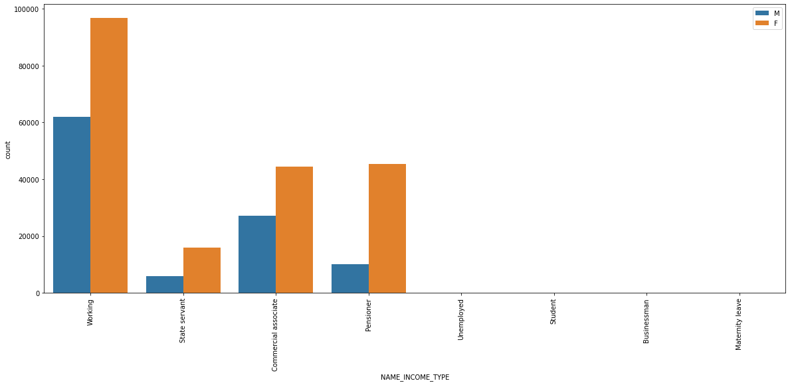
DISTRIBUTION OF NAME_INCOME_TYPE
Points to be concluded from the Graph on right side.
Female workers are much more than male workers

Slide 6
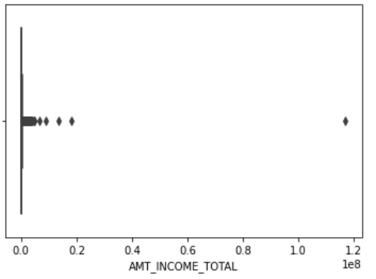
BOX PLOT FOR AMT_INCOME_TOTAL
Points to be concluded from the Graph on right side.
As you can see from the plot there is value too high compared to others it is an outlier.

Slide 7
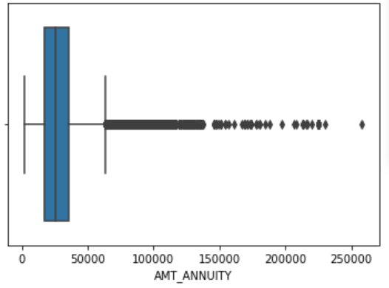
BOX PLOT FOR AMT_ANNUITY
Points to be concluded from the Graph on right side.
As you can see from the plot there are values too high compared to others it is an outlier.

Slide 8
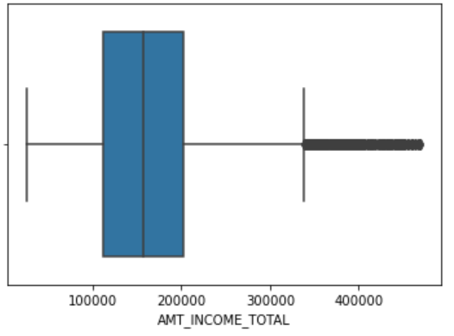
BOX PLOT FOR AMT_INCOME_TOTAL AFTER REMOVING OUTLIERS
Points to be concluded from the Graph on right side.
The plot on right side is after removing values outside 99 Percentile

Slide 9
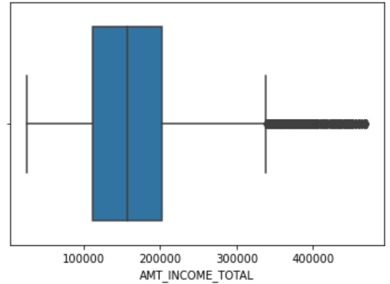
BOX PLOT FOR AMT_ANNUITY AFTER REMOVING OUTLIERS
Points to be concluded from the Graph on right side.
The plot on right side is after removing values outside 99 Percentile

Slide 10
CHECKING THE IMBALANCE
Separating the dataset into two parts target1 = Clients with Payment Difficulties and target0 = all other clients.
Calculating Imbalance percentage using target0 and target1 datasets gives defaulted population percentage as 11.27%.

Slide 11
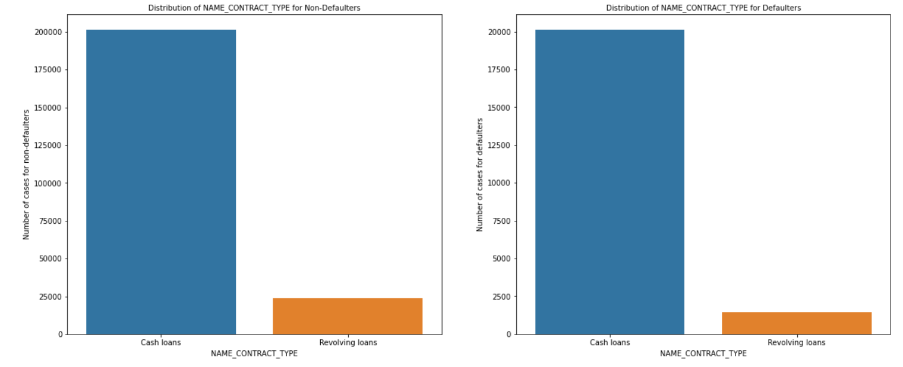
DISTRIBUTION OF NAME_CONTRACT_TYPE VS DEFAULTERS & NON-DEFAULTERS
Points to be concluded from the Graph on right side.
Revolving Loans are lesser in Defaulters as compare to Non Defaulters

Slide 12
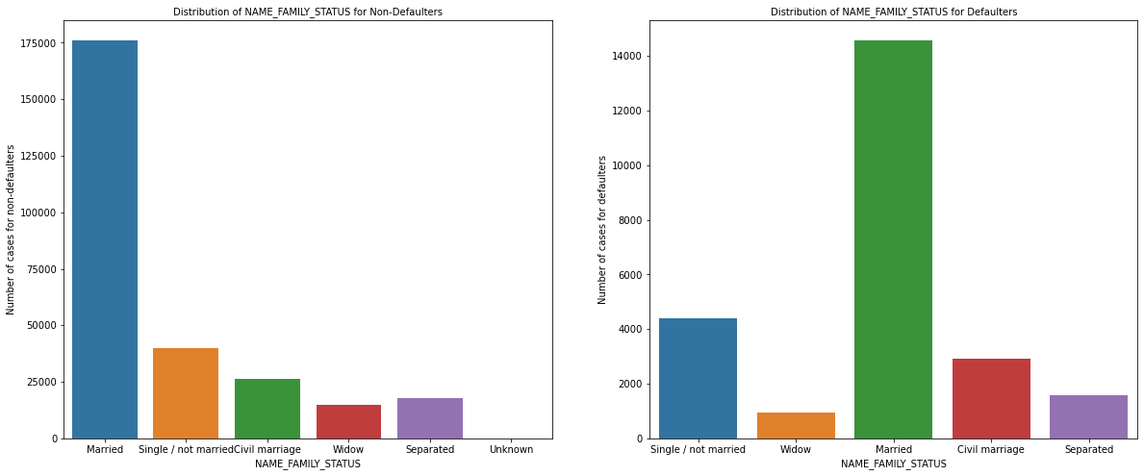
DISTRIBUTION OF NAME_FAMILY_STATUS VS DEFAULTERS & NON-DEFAULTERS
Points to be concluded from the Graph on right side.
Single or Not married persons are higher in defaulters list as compared to non defaulters
In Defaulters plot Married clients are more defaulters when compared to others
Widow Defaulters are less when compared to Widow Non Defaulters

Slide 13
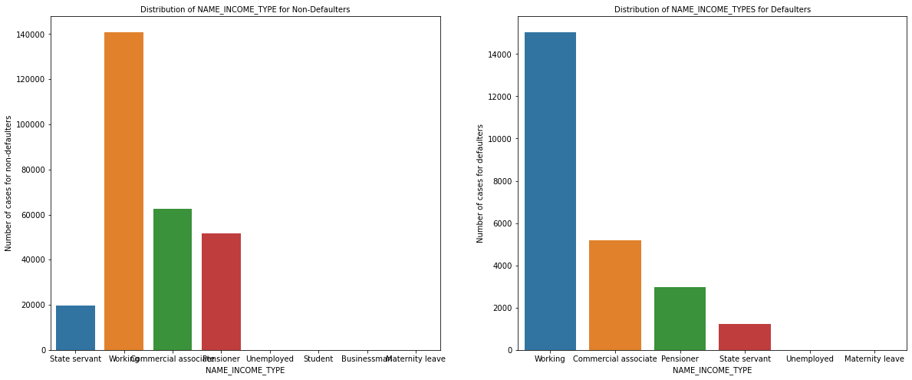
DISTRIBUTION OF NAME_INCOME_TYPE VS DEFAULTERS & NON-DEFAULTERS
Points to be concluded from the Graph on right side.
Commercial associates are comparatively less in defaulter list as compare to Non defaulter list.
Pensioners are comparatively less in defaulter list as compare to Non defaulter list

Slide 14
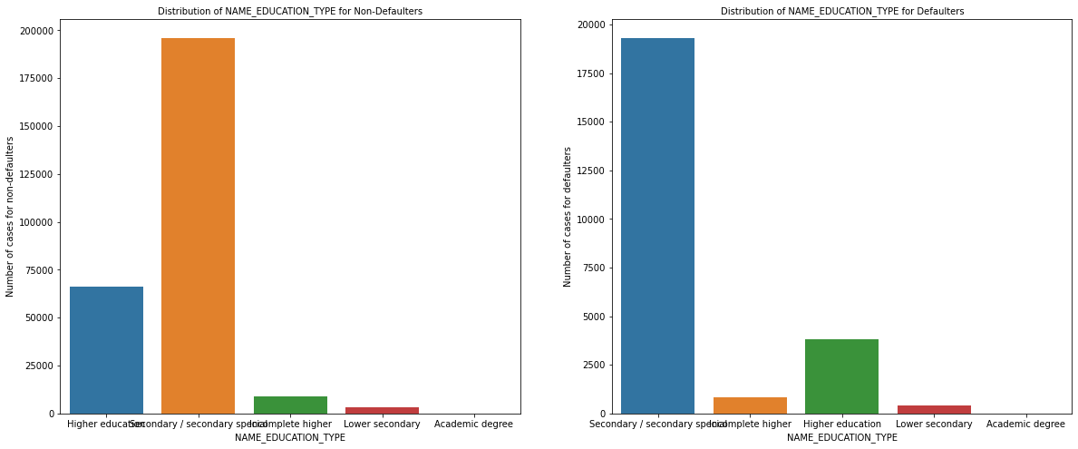
DISTRIBUTION OF NAME_EDUCATION_TYPE VS DEFAULTERS & NON-DEFAULTERS
Points to be concluded from the Graph on right side.
Higher Educated People are Less Defaulters.

Slide 15
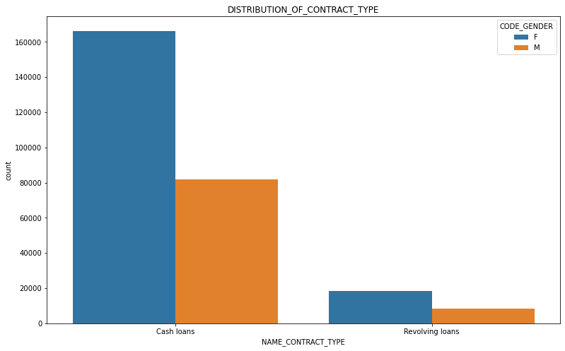
DISTRIBUTION OF NAME_CONTRACT_TYPE VS DEFAULTERS & NON-DEFAULTERS
Points to be concluded from the Graph on right side.
Female count is more than Male count
Cash loans having higher density as compared to Resolving loans

Slide 16
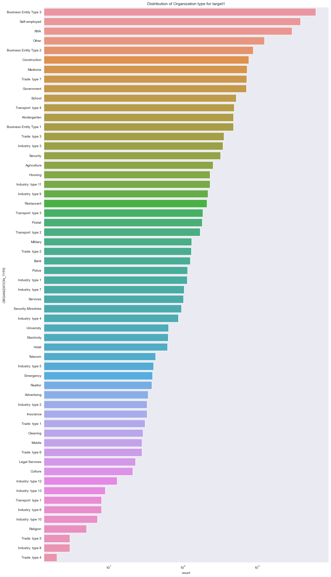
DISTRIBUTION OF ORGANIZATION TYPE FOR TARGET1
Points to be concluded from the Graph on right side.
Clients applied for loan are mostly from Business Entity type 3 or self employed
Clients applied for loan are less from Industry type 8,type 5 and type 4.

Slide 17
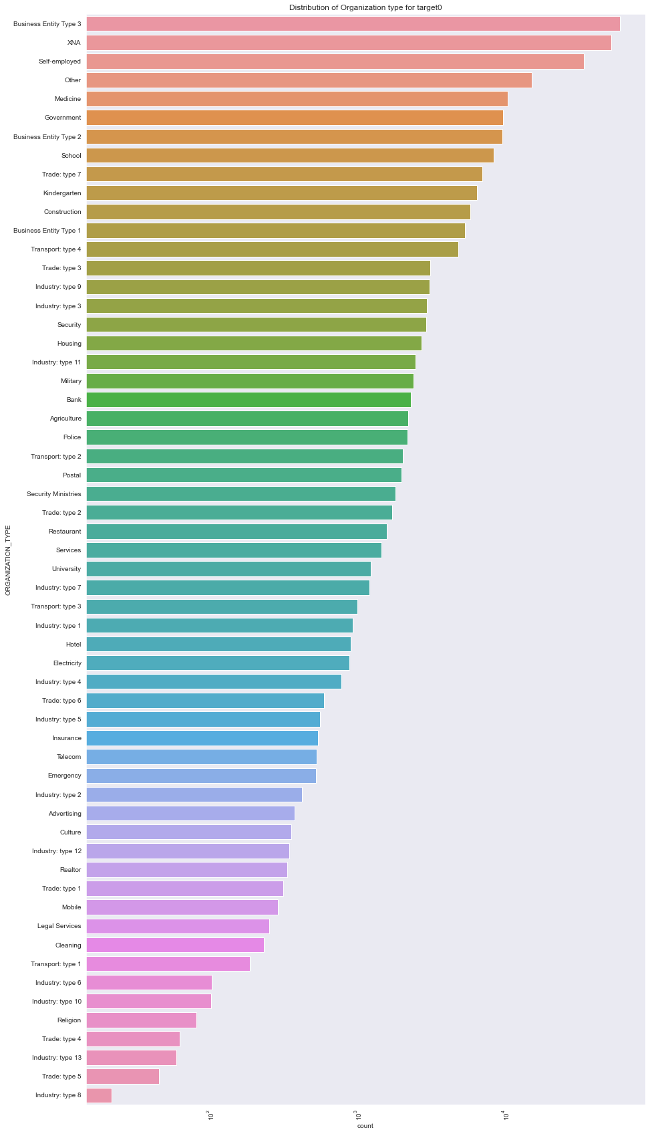
DISTRIBUTION OF ORGANIZATION TYPE FOR TARGET0
Points to be concluded from the Graph on right side.
Clients applied for loan are mostly from Business Entity type 3 or self employed
Clients applied for loan are less from Industry type 8,type 5 and type 4.

Slide 18
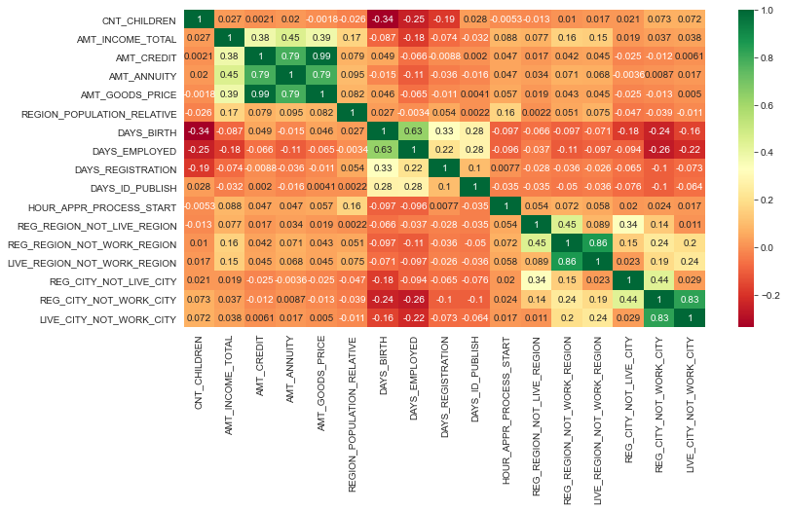
CORRELATION FOR TARGET0

Slide 19
Inference from Correlation Heat map for target0
AMT_INCOME_TOTAL is inversely proportional to CNT_CHILDREN, means less children more income and more children less income.
AMT_CREDIT is inversely proportional to CNT_CHILDREN, means more credit for less children.
The income is higher in densely populated area.
AMT_CREDIT is higher to densely populated area.

Slide 20
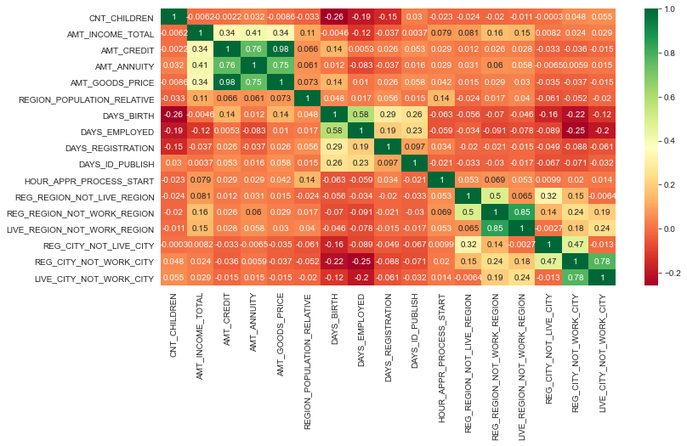
CORRELATION FOR TARGET1

Slide 21
Inference from Correlation Heat map for target1
Both Correlation looks similar and not much can be inferred from the Correlation Heatmaps

Slide 22
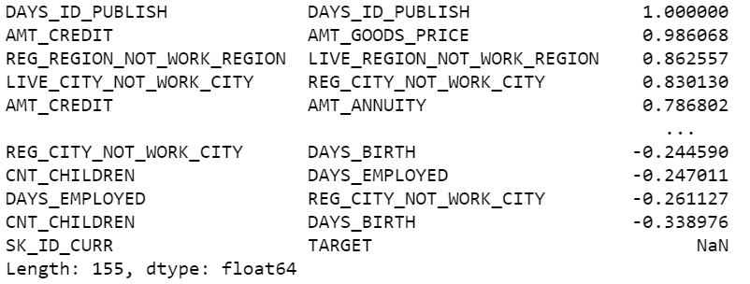
Below data shows 10 correlations for non defaulters

Slide 23
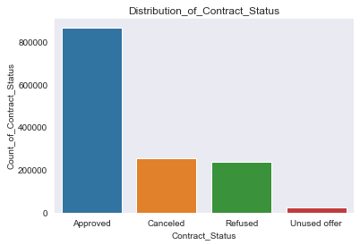
DISTRIBUTION OF CONTRACT STATUS
Points to be concluded from the Graph on right side.
62.02% of Contract Status are approved
18.14% of them are canceled
17.13% of them are Refused
1.60% of them are Unused offer

Slide 24
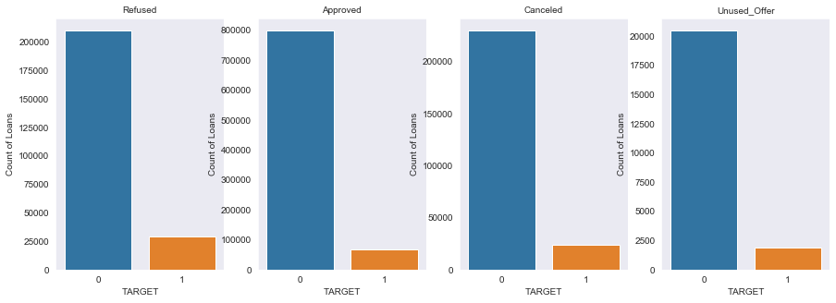
DISTRIBUTION OF CONTRACT STATUS VS COUNT OF LOANS
Points to be concluded from the Graph on right side.
Loans for Refused Contract Status have higher default rate than for other Contract Status

Slide 25
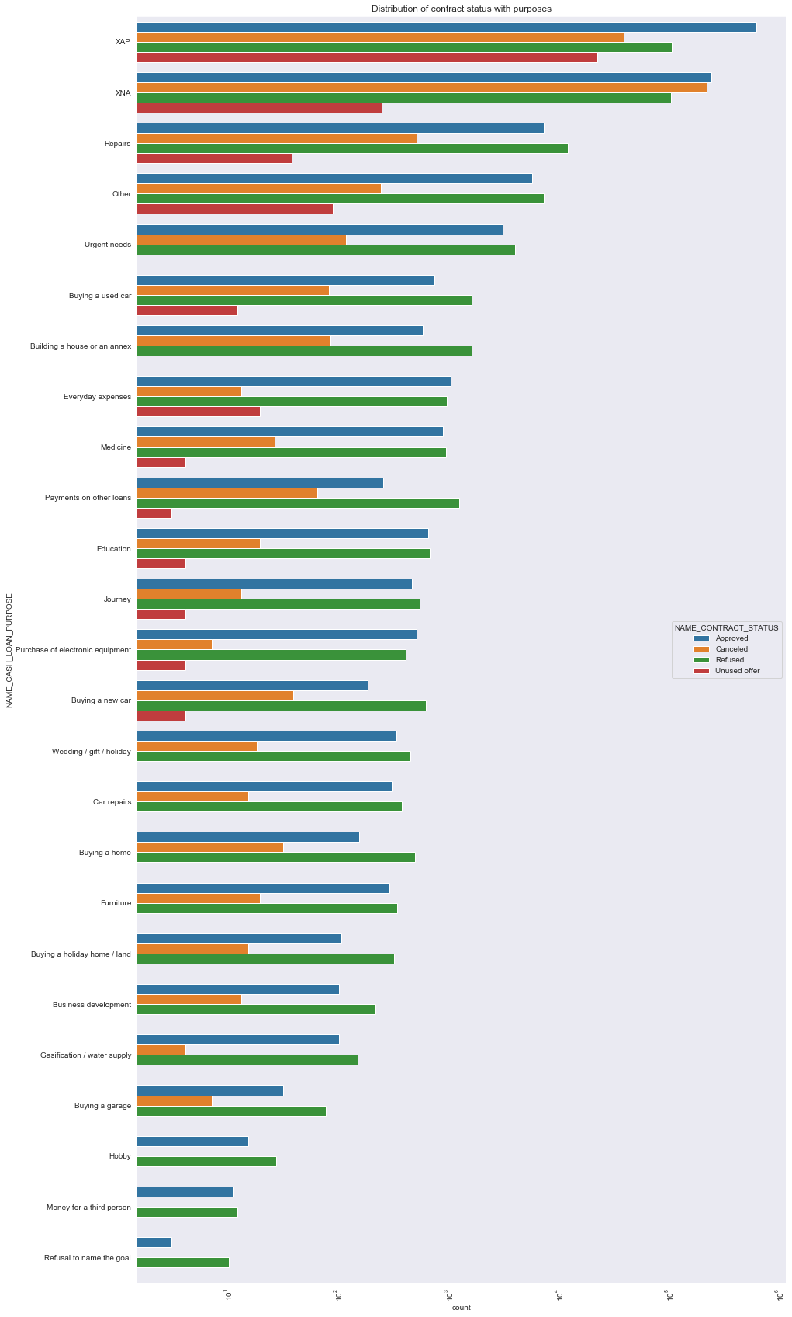
DISTRIBUTION OF CONTRACT STATUS IN LOGARITHMIC SCALE
Points to be concluded from the Graph on right side.
Repairs, others, urgent needs etc. have high refusal rate
Hobby, Money_for_a_third_person, Refusal_to_name_the goal always uses offers

Slide 26
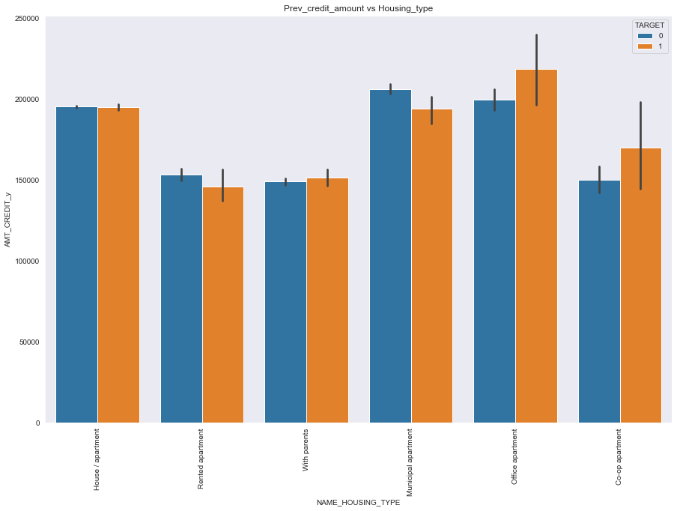
DISTRIBUTION OF PREV_CREDIT_AMOUNT VS HOUSING_TYPE
Points to be concluded from the Graph on right side.
Bank should avoid giving loans to the housing type of co-op apartment as they are having difficulties in payments
Bank should focus on housing type with parents or House\Apartment or municipal Apartment for successful payments

Slide 27
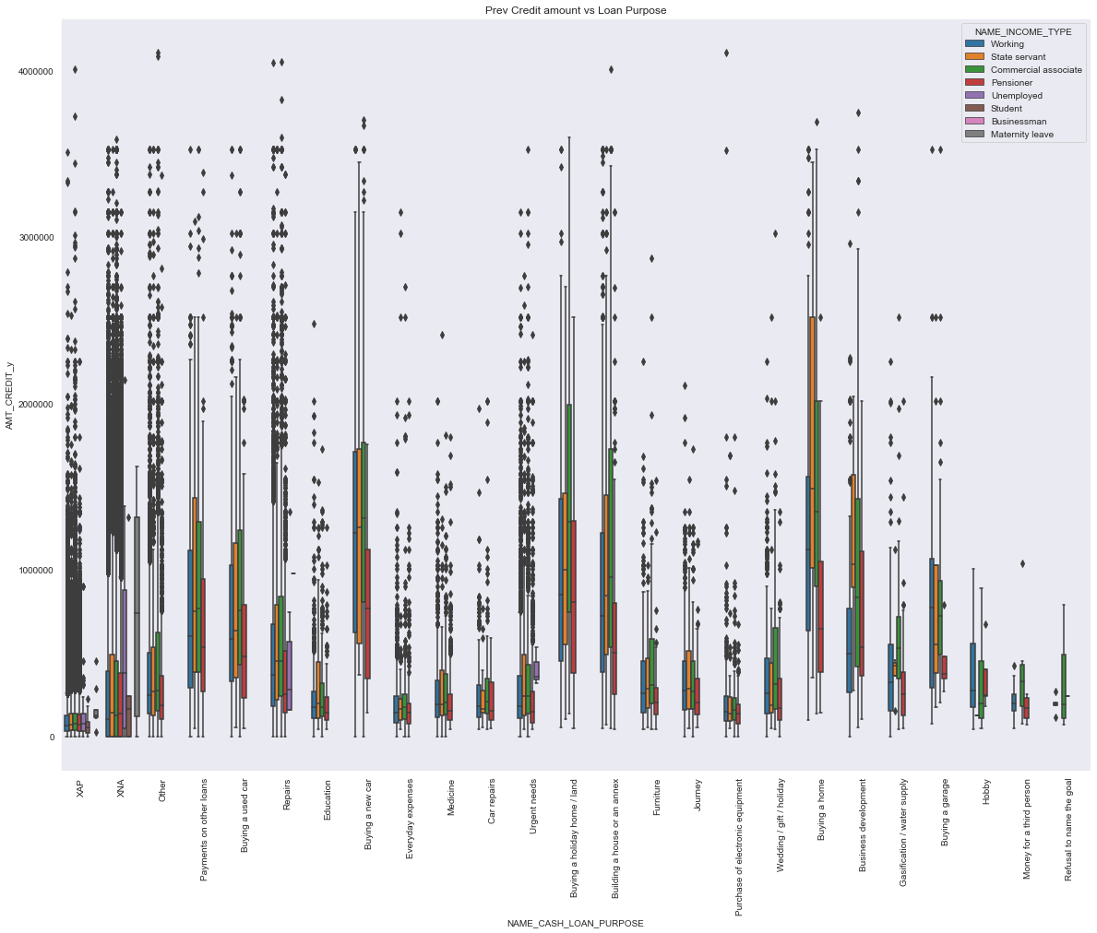
DISTRIBUTION OF PREV CREDIT AMOUNT VS LOAN PURPOSE
Points to be concluded from the Graph on right side.
We can conclude that hobby, money for third person, refusal to name the goal is less credit applied
For buying a new car, buying a home, Buying holiday home credit amount of loan is Higher

Slide 28
CONCLUSIONS
The proportion of defaulters is 11.27%
Bank should give more revolving loans
Bank should focus more on contract type ‘Student’, ‘pensioner’ and ‘Businessman’
Bank should focus on with housing type other than ‘Co-Op Apartment’.
People with Higher Education are less defaulters
Loans previously refused has higher default rate.

